Slide 1
Classification Approaches for the Letter Recognition Analysis

Slide 2
Letter Data
What is our goal with the letter data?
Develop a model that can recognize letter based on characteristics of the image.
Why is this goal important?
We can digitize historical documents easier.

Slide 3
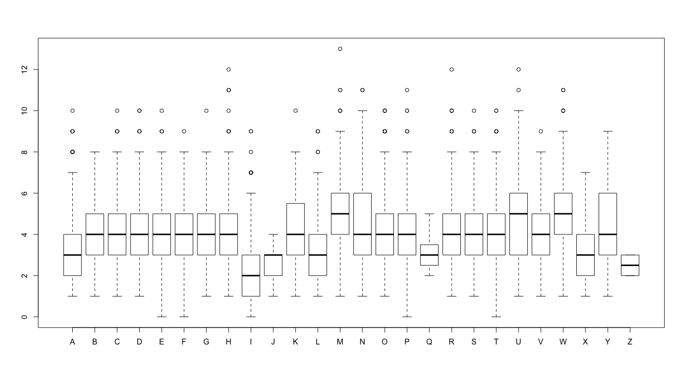

Slide 4
Letter Data
What are the challenges with the Letters data?
Multiple-category response.
Hard to assess relationship between covariates and responses.
Possible Approaches:
Logistic Regression
Discriminant Analysis
K-Nearest Neighbors
Support Vector Machines
Neural Networks
Classification Tree
Trees: Bagging, Random Forests, Boosting, BART

Slide 5
Big idea
$f_{k}$(x) for each class k=1,…,K
Probability for a class is $\frac{f_{j}(x)}{\sum_{k=1}^{K}{f_{k}\left(x\right)}}$

Slide 6
Logistic Regression
Logistic Regression Model:
Multinomial Logistic:

Slide 7
MN-Logistic Regression
Multinomial Logistic Regression Model:
How do we interpret
For every unit increase in , the log-odds ratio relative to category K increases by
Just interpret the sign: If , then increases as increases.
Draw a picture.

Slide 8
MN-Logistic Regression
How do we estimate
Maximum likelihood – remember that we assumed the multinomial distribution.
library(nnet); multinom()
How do we get uncertainty measurements (e.g. CIs)?
Asymptotics or bootstrap.
How do we do prediction?
Plug in and predict the probabilities.

Slide 9
Discriminant Analysis
Bayes Theorem for Classification (Revisited):
Recall in DA: Assume is random and factor the joint distribution
Using Bayes Theorem:

Slide 10
Discriminant Analysis
Discriminant Analysis Classification: Assign to the class that maximizes,
Note #1: Technically, this is “quadratic” discriminant analysis. “Linear” discriminant analysis assumes

Slide 11
Naïve Bayes
Naïve Bayes Classification: A special type of discriminant analysis where each explanatory variable is independent. The joint distribution can then be factored as
Note: In naïve Bayes, if x_{p} is quantitative then is Gaussian and if x_{p} is categorical then is multinomial.
Note 2: If histograms of your explanatory variables, its probably best to not assume Gaussian and rather use density() to estimate each marginal distribution.

Slide 12
Discriminant Analysis
Discriminant Analysis Classification:
Issues:
What do we use for

Slide 13
K-Nearest Neighbors
K-Nearest Neighbors Algorithm (Non-parametric):
To classify a point which has covariates
Find the K-nearest neighbors according to some distance
Approximate,
where is the set of nearest neighbor points.
Classify according to majority vote.

Slide 14
Support Vector Machines
Extending SVMs to more than 1 class is on-going work but here are a few ideas:
One vs. one
Construct “K choose 2” SVMs, tally number of times classified as class j, assign to largest majority.
Cascading
Class 1 vs 2:K, Class 2 vs 3:K…Class K-1 vs K
One vs. All
Construct K SVMs, assign to class with largest

Slide 15
Classification and Regression Trees - CART
Estimators:
Regression Trees:
Classification Trees:

Slide 16
Tree Ensembles
Like CART, but with many trees that get to vote:
Reg. Trees
Class. Tree – “majority vote”

Slide 17
Neural Networks
Intuition for Neural Networks:
Problem: Non-linear relationship between X and Y
Neural Net Solution: Non-linearly transform X→Z such that Z relates linearly to Y.

Slide 18
Neural Networks
Regression w/Neural Nets Model Setup:

Slide 19
Neural Networks
Regression w/Neural Nets Model Setup:

Slide 20
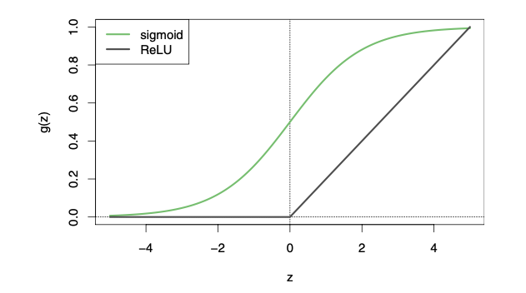
Neural Networks

Slide 21
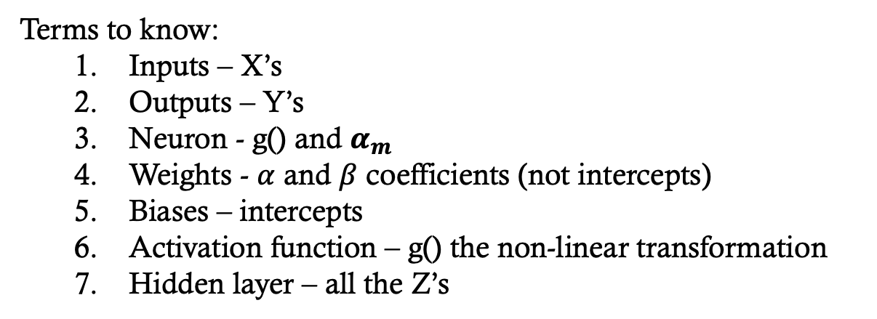
Neural Networks Terminology
Terms to know:
Inputs – X’s
Outputs – Y’s
Neuron - g() and $α_{m}$
Weights - $α$ and $β$ coefficients (not intercepts)
Biases – intercepts
Activation function – g() the non-linear transformation
Hidden layer – all the Z’s

Slide 22
Fitting Neural Networks
Model Fitting:

Slide 23
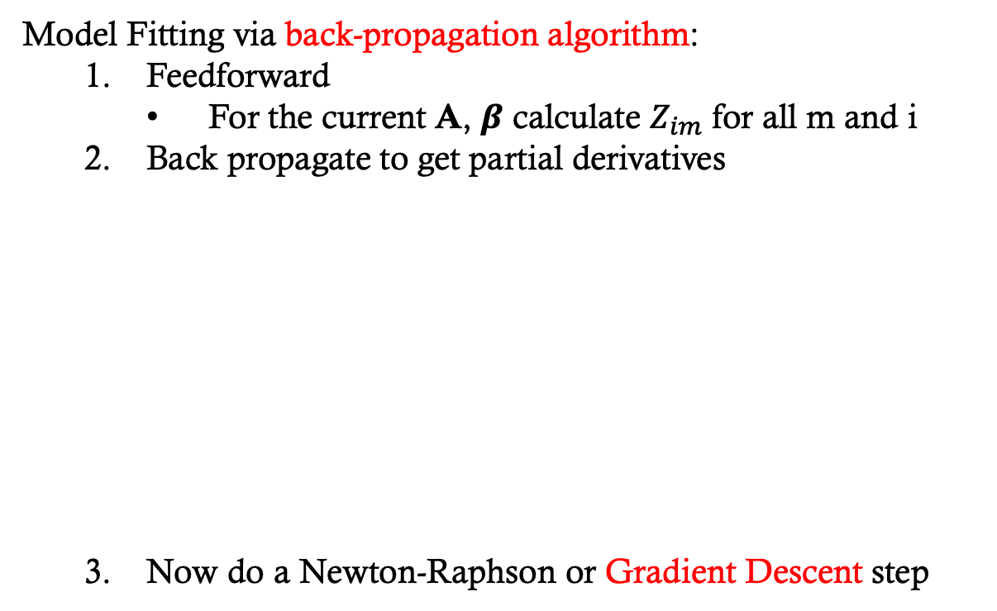
Fitting Neural Networks
Model Fitting via back-propagation algorithm:
Feedforward
For the current A, $β$ calculate $Z_{im}$ for all m and i
Back propagate to get partial derivatives
Now do a Newton-Raphson or Gradient Descent step

Slide 24
Fitting Neural Networks
Issues w/Model Fitting via back-propagation:
Even w/penalty they can still overfit. Some solutions are:
Only minimize loss on some the data at a time --> split training data into batches then iterate through batches minimizing loss (error). The epochs are the number of iterations the full dataset is used (Num_iter = Num_batches*Num_epochs)
Example
N = 100,000,000
Batch size = 1000
1 Epoch = 100,000 iterations

Slide 25
Fitting Neural Networks
Issues w/Model Fitting via back-propagation:
Even w/penalty they can still overfit. Some solutions are:
Only run a few iterations of the back-propagation algorithm so you are close to minimization but not quite there.
Take small steps in backpropagation algorithm (small learning rate).

Slide 26
Fitting Neural Networks
Tuning: Neural Networks can easily overfit the data causing terrible predictions - tuning takes skill. To tune do the following:
Center/scale the data via z-score or [-1,1] or [0,1] (including the response if quantitative)
Tune the number of hidden variables (M) to cross-validated data.
If needed, add more layers (deep learning) but still cross-validate:

Slide 27
Fitting Neural Networks
Tuning: Neural Networks can easily overfit the data causing terrible predictions – tuning takes skill. To tune do the following:
Center/scale the data via z-score or [-1,1] or [0,1] (including the response if quantitative)
Tune the number of hidden variables (M) to cross-validated data.
If needed, add more layers (deep learning) but still cross-validate.
Minimization problem is non-convex so easily gets stuck in local modes. So, run optimization from many starting values.
Tune: epochs, batch size, learning rate, etc.

Slide 28
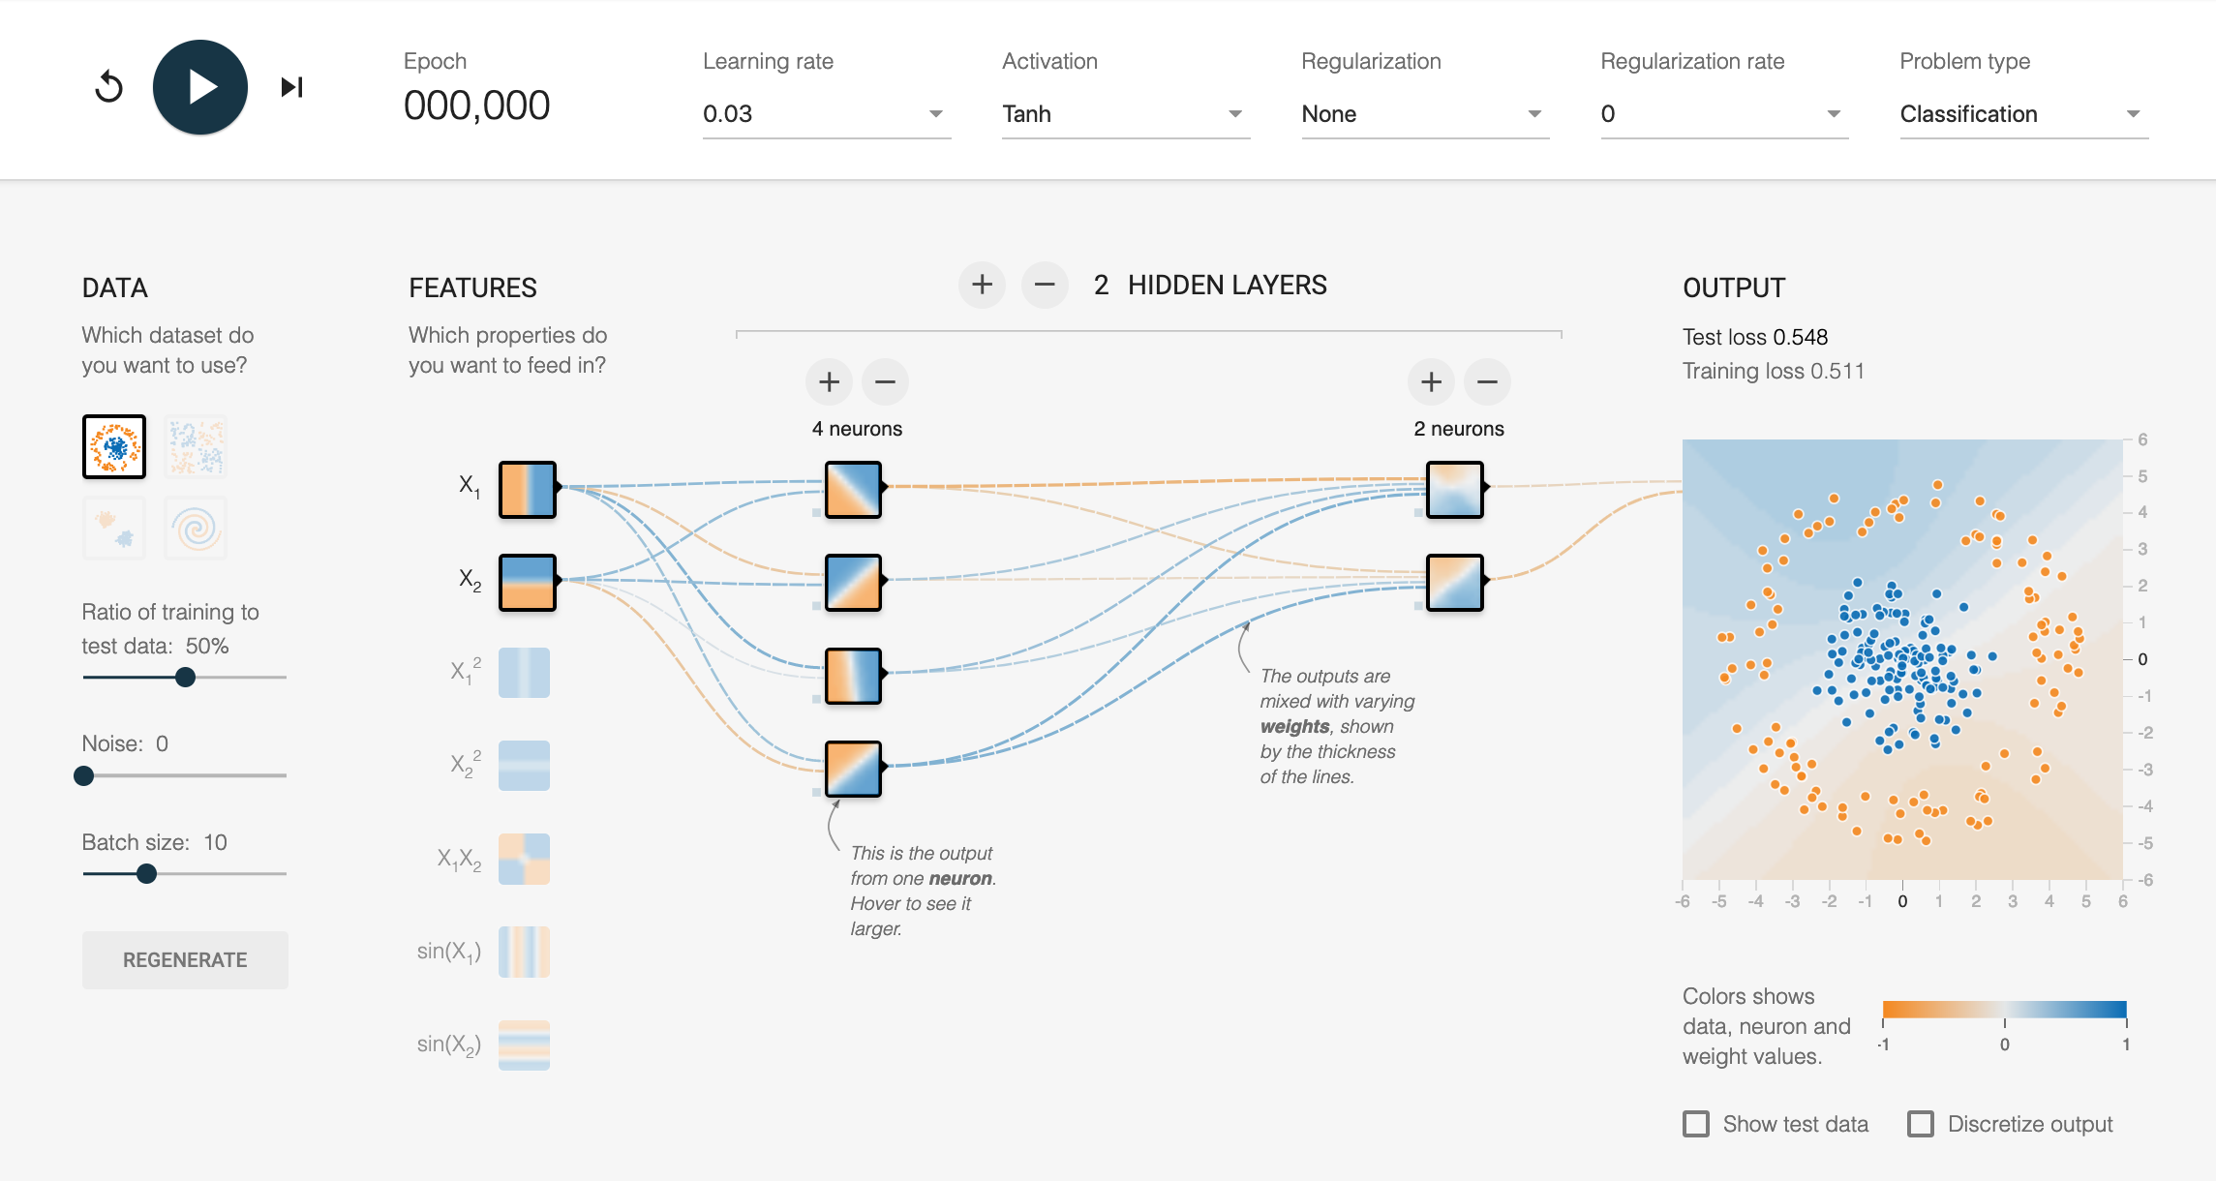
Fitting Neural Networks
Neural Network Playground: playground.tensorflow.org

Slide 29
Fitting Neural Networks
Code: R’s *own* implementations of neural nets (e.g. the neuralnet library) are not great. The caret, keras, or Rtorch packages have different implementations. Note keras and Rtorch call python code for you. Look at any of the following online tutorials:
https://keras.rstudio.com/
https://www.datacamp.com/community/tutorials/keras-r-deep-learning
torch.mlverse.org

